Slide 1

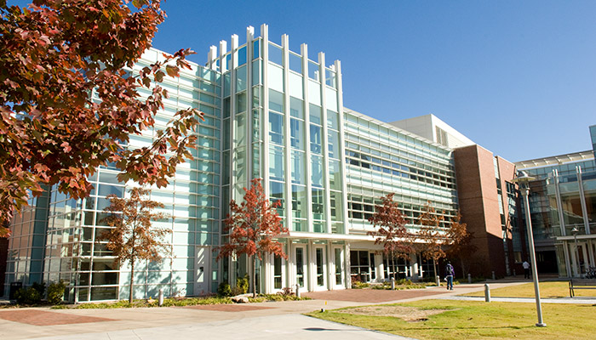
From large graphs to large neural networks
Constantine Dovrolis
CaSToRC – The Cyprus Institute
School of Computer Science – Georgia Tech

Slide 2
Outline
What is Network Science?
Basics about graphs and random networks
Classes of network models
Statistical sampling and inference on graphs
Machine learning on graphs
Graph Neural Networks
Modular networks and community detection
Dynamic processes on networks: epidemics

Slide 3
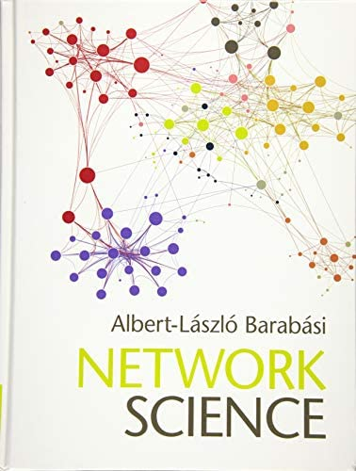


Some introductory textbooks

Slide 4


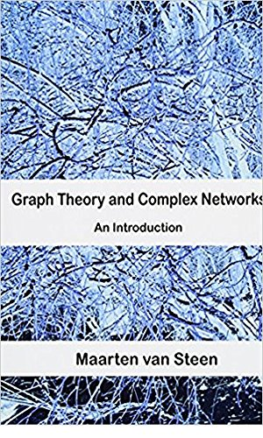
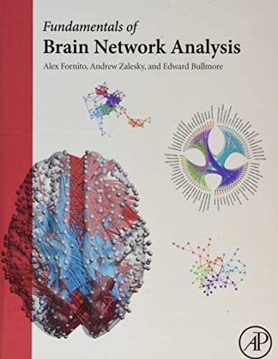
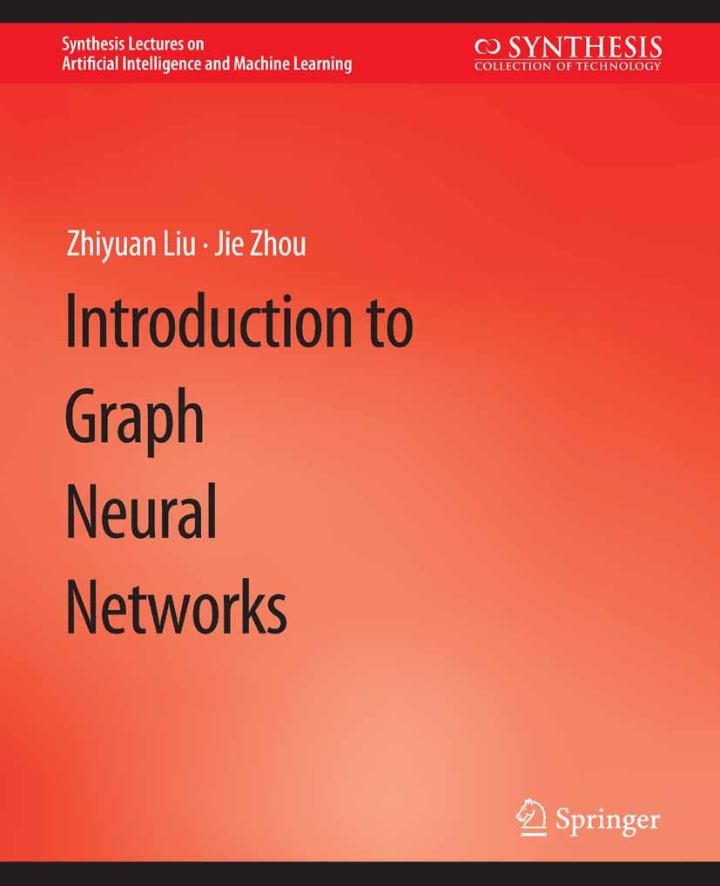



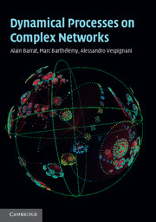
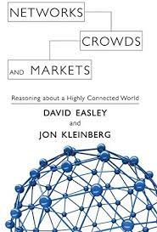
More specialized textbooks

Slide 5
Networks are everywhere

Slide 6
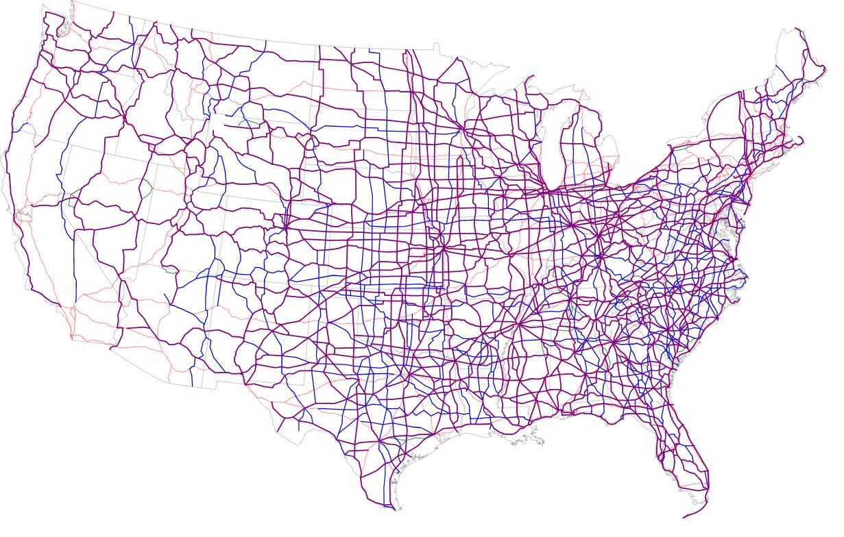
A
B
2
4
5
8
D
C
F
3
7
6
4
E
H
G
5
2
Highway Network & Weighted Graphs
Notes:
Here is an example of a transportation network, showing the Urban and Rural Interstate highways and Other major highways in the US.
The nodes in such a network could be all junction or entry/exit points on a highway, while the edges can be the highway segments between such points. <CLICK>
Note that a network of this type would typically have weighted edges, meaning that each edge would be associated with a number showing its capacity (e.g., the number of lanes at that highway segment).

Slide 7
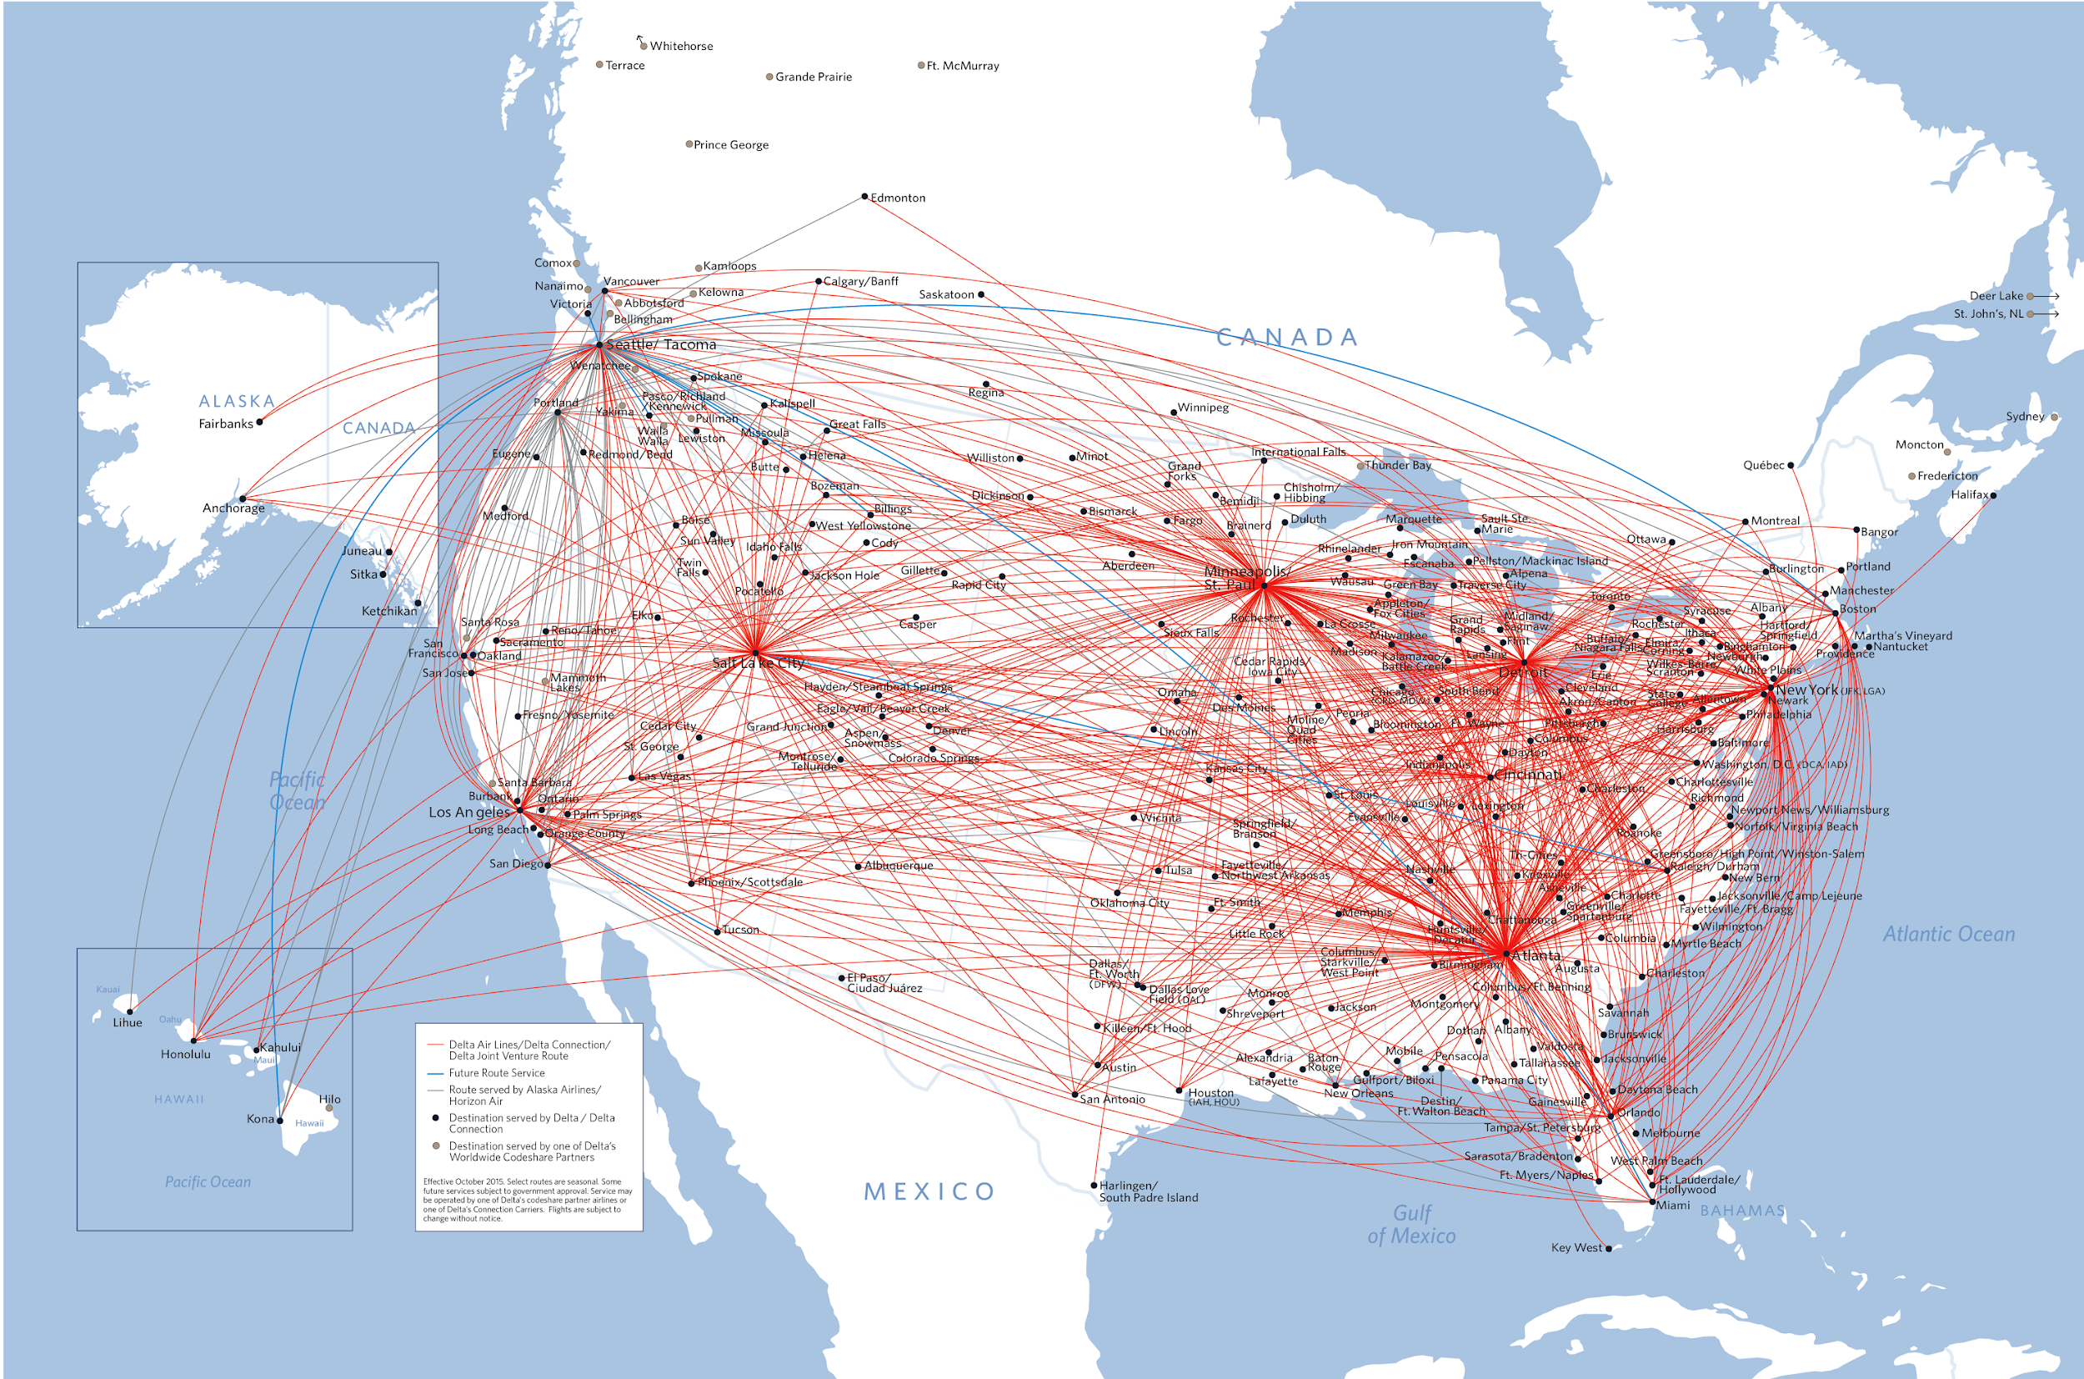
Delta Route Map – Hubs and Small-World effect
Notes:
Here is another transportation network example, this time for the direct flights of Delta Airlines in North America.
This network would also be weighted (even though the weights are not shown in this visualization), with the weight of each edge being the number of available seats in all flights between the corresponding two airports on a daily basis. <CLICK>You can actually find such data for every airline through the Bureau of Transportation Statistics, which is part of the US Department of Transportation. See the link below this video.

Slide 8
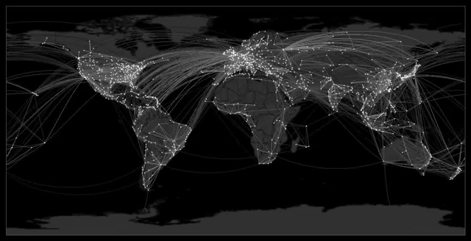
Epidemics Diffusion processes on social networks
By Dirk Brockmann -- https://www.youtube.com/watch?v=mm2u9RKwgsY&feature=youtu.be

Slide 9
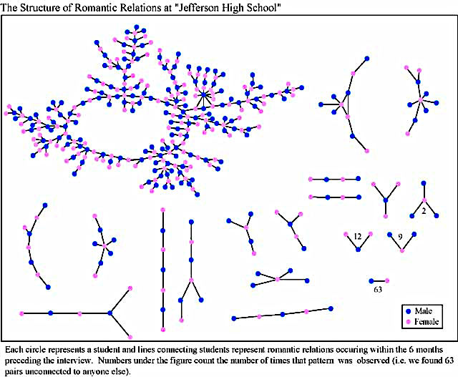
The Structure of Romantic Relations at “Jefferson High School”
Each circle represents a student and lines connecting students represent romantic relations occurring within 6 months preceding the interview. Numbers under the figure count the number of times the pattern was observed. (i.e. we found 63 pairs unconnected to anyone else)
Heterogeneity
Romantic/Sexual Relations in a Highschool
Notes:
Lets move now from technological to human, or ”social” networks. In these networks the nodes are typically specific individuals and the edges represent different types of relation or contact.
For instance, this figure is based on data from a very interesting study at a high school. 800 students were asked whether they had sexual relations during the past 6 months with another student at the same school. The network shows only those individuals that had at least one such relation in the given time period.
Note that the network in this case does not consist of a connected graph – there are several “connected components”, with one of them <click> (at the top left) being much larger than all others. This is common in most real-world networks: there may be more than one connected components but typically one of them covers the majority of the nodes.
<click> Note that most nodes have a small number of connections (for example there are 63 pairs of nodes that do not connect to anyone else) – but there are also few nodes with a much larger number of connections. This heterogeneity is a common property of many real-world networks.

Slide 10
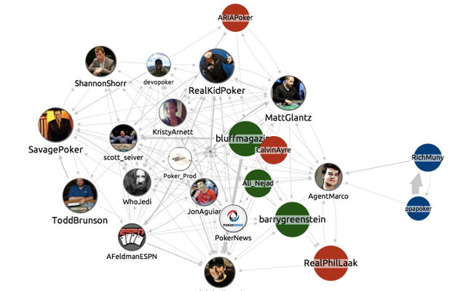
Bidirectional Edge
4
2
3
Bidirectional Edge
1
Directed Edge
Online Social Networks – Influence and Diffusion
Notes:
Online social networks have transformed our lives in the last 15 years or so. Here you see a small portion of the Twitter network, showing the connections between a number Poker players.
In Twitter, a user can choose to follow another user. <click> This means that the edges in the network are Directed, from one node to another. <click> Of course we can also have bidirectional edges when two people follow each other.

Slide 11
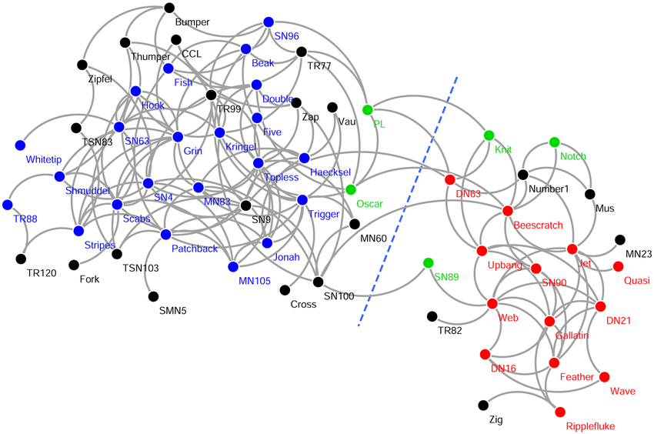

GROUP C
GROUP A
Not Included in Study
GROUP B
Bottlenose Dolphins - Communities
Notes:
By the way, social networking is not a human invention. A large number of species create complex and dynamic social networks.
<click>This network refers to 62 dolphins that were monitored for a period of about 7 years. Two individuals are connected if they spend significant amount of time swimming together. The researchers that first performed this study noticed two strongly formed communities,<click> the blue and the red, and a more weakly formed community <click> (the green) that often interacts with both the blue and red communities. <click>The dolphins shown as black dots were not included in the original data analysis.
<click> The blue dashed line represents how a community detection algorithm would separate the dolphins into two groups, without any information about the color of each node. Note that the algorithm is doing a pretty good job separating the blue and red communities – and it also suggests what group the black nodes most likely belong to.

Slide 12
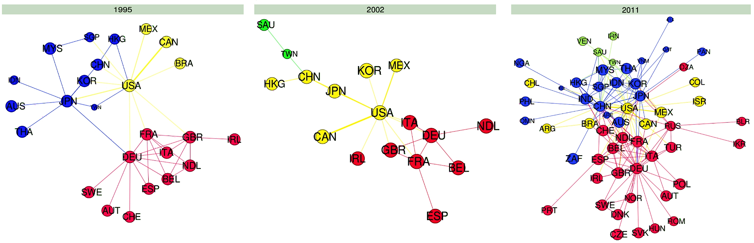
1995
2002
2011
Dynamic Network – a network that changes overtime
World Trade Networks – Dynamic networks
Notes:
Networks sometimes refer to the exchange of products, materials or just money. Such networks are valuable in the field of economics and finance.
The networks here show three different snapshots, <click> from 1995 to 2011, showing the trade volume between different countries (only the countries with the largest trade values). The visualization does not show numbers but the edges are in fact directed and weighted, showing the total trade volume from country X to country Y during that year.
<click> This is a good example of a dynamic network – a network that changes over time. Note how much denser the network has gradually become. You can also see many other interesting changes, such as the major shift of China from a peripheral to a central role in the world trade network network.
If you want to analyze this data yourself, they are publicly available at the World Trade Organization link shown below

Slide 13
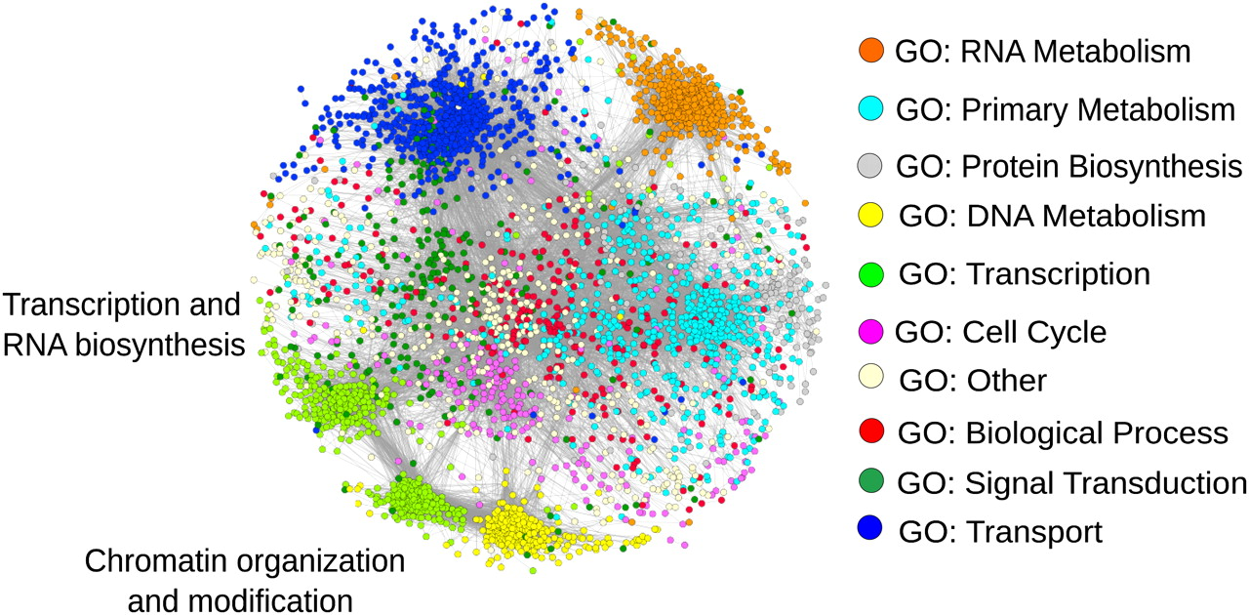
Protein One
Protein Two
Protein-protein Interaction
Protein Interaction Networks – Centrality metrics
Notes:
Lets now switch to biological systems. There are several mechanisms in a living cell that depend on network interactions – rather than individual chemical reactions or molecules.
<click>Most of the functions of a biological cell are performed through proteins. You can think of proteins as “lego pieces” of specific shape and size that can interact with other proteins to perform a certain function, such as signal transduction, transport of other proteins, or DNA transcription, as shown at the top-right.
<click>The set of all possible interactions between protein pairs in a cell forms the Protein-Protein Interaction (PPI) network of that cell. This network is extremely important not only in understanding how the cell performs each function – but also to understand diseases in which one or more proteins does not fold properly (such as Alzheimer’s, ALS or sickle cell disease). Additionally, PPI networks are instrumental in designing drugs that target specific viruses or other pathogens.
<click>This figure shows the PPI network of a single-cell organism called Fission Yeast, and it consists of about 3400 proteins and 37000 interactions. The different colored clusters in the network correspond to specific biological functions. As you can see most functions are performed by groups of highly interconnected proteins – but there are also many proteins that bridge those clusters, contributing in more than one biological function.

Slide 14
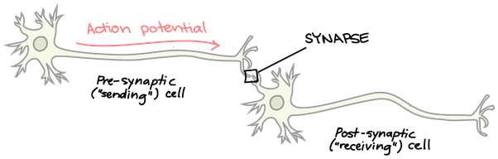
Neurons and Synapses
Notes:
(first show the picture at the top left – then with animation show the lower picture)
The brain is also a system that is actively studied as a network – both at the level of individual neurons, and at a lower spatial resolution (at the level of brain regions).
The figure at the top shows a sketch of two neurons that connect syntactically. <click> When the left neuron (called pre-synaptic) “fires” (i.e., it generates an action potential), the receiving neuron at the right <click>(post-synaptic) will get depolarized and may also generate an action potential. Note that the connection is directed – and weighted by the number and strength of the corresponding synapses.
<click> Our brain is nothing but a huge network of such interconnected neurons – the human brain includes about 86 Billion neurons and more than 100 Trillion Synapses – a huge network indeed! But it is important to pause for a moment and consider that all our impressive capabilities (and fallacies!) mind are generated not by the complexity of individual neurons – but by the complexity of the network that interconnects those neurons. The neurons in the human brain are practically the same cell as the neurons in any other animal. What makes us humans rather than flies or cats is the network within our skull.

Slide 15
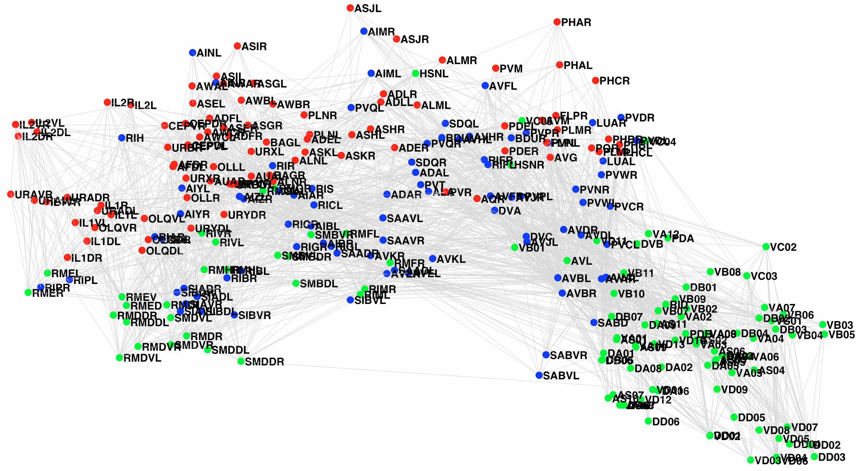
Interneurons
Sensory Neurons
Motor Neurons
Complete Neural Net of C-elegans
Notes:
As mentioned earlier in this lesson, we know the complete neural network of few species – such as the microscopic worm C.elegans.
This visualization shows neurons with three different colors, <click> red for sensory neurons (providing input to the neural system), <click> green for motor neurons (generating output action by connecting to muscles), and <click> blue for interneurons (“computing” the intermediate-level functions).

Slide 16
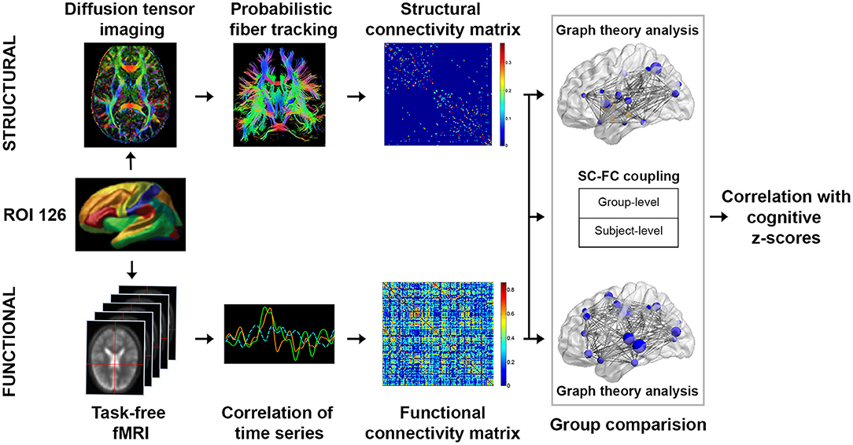
Structural & Functional Brain Networks
Notes:
It is extremely unlikely that we will have similar maps for the entire human brain in the near future. Instead, the human brain network is usually studied at a coarser-level of spatial resolution using Magnetic Resonance Imaging (MRI), which is a non-invasive neuroimaging technology.
Diffusion-weighted MRI provides maps showing how different brain regions (down to a voxel dimension of about 1mm) are connected to each other. These anatomical connections can be inferred using some very interesting algorithms that perform “tractography”, and they allow us to create <click> structural brain networks, as shown at the upper part of the figure.
<click> Functional MRI (fMRI) on the other hand provides a timeseries for each brain region, showing how active that region is as function of time. This depends of course on the cognitive task that the subject performs during the MRI scan. The spatio-temporal correlations between different brain regions allows us to construct functional brain regions, as shown at the lower part of the figure.
We will discuss in more technical detail how to infer and analyze functional networks derived from spatio-temporal data later in the course.

Slide 17
How do the structural properties of the network affect the dynamics/evolution of the corresponding complex system?
Based on concepts, methods from:
Graph theory
Data mining
Machine learning
Nonlinear dynamics
Game theory
Statistical mechanics
Image source

Slide 18
Basic concepts

Slide 19
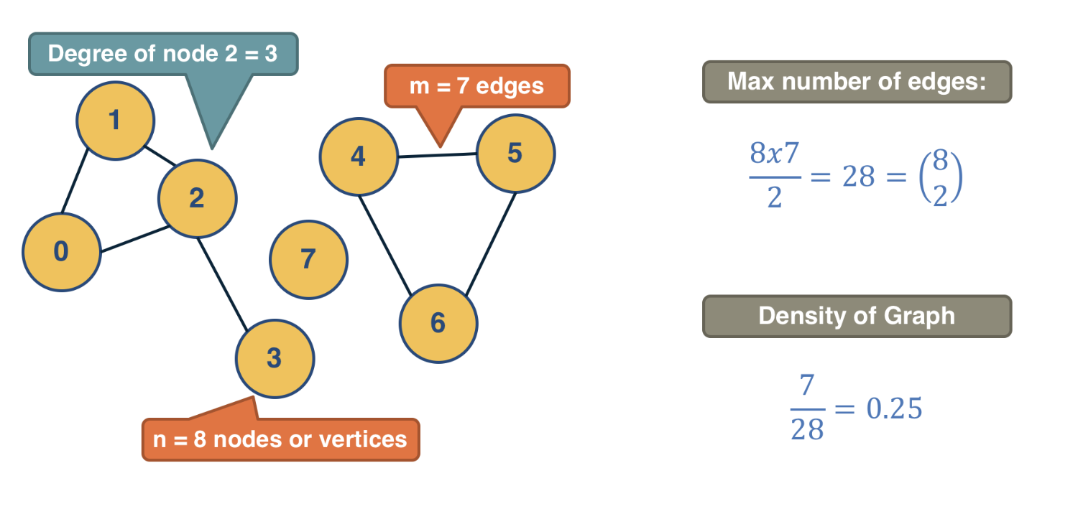
Nodes, edges, density, degree

Slide 20
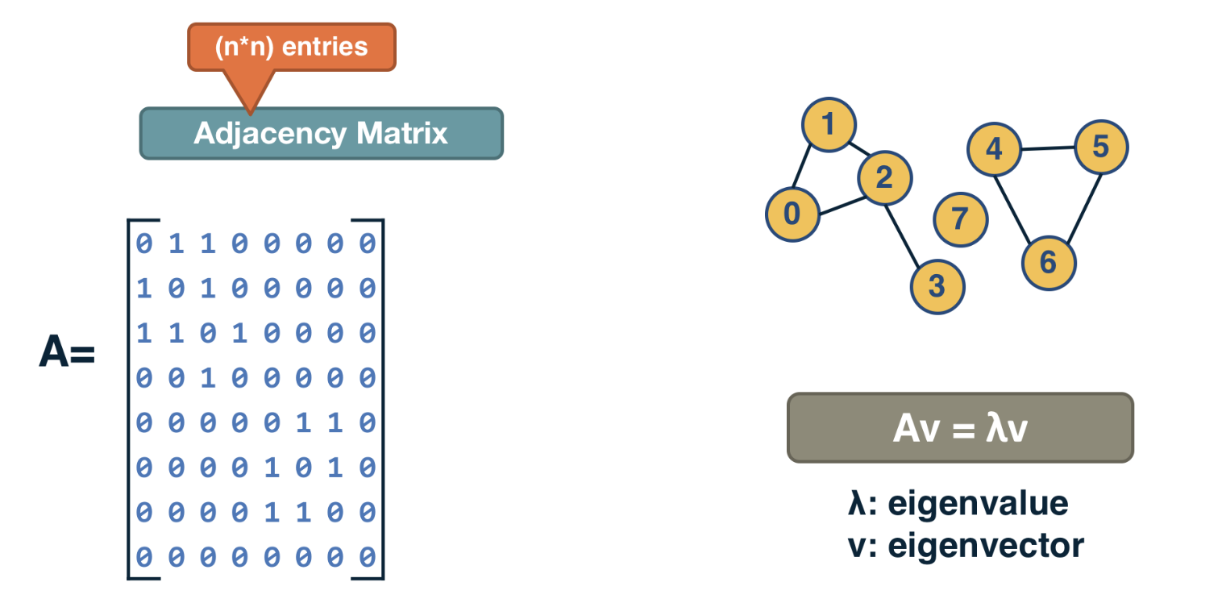
Adjacency matrix
Example: the largest eigenvalue of A is bounded above by maximum degree

Slide 21
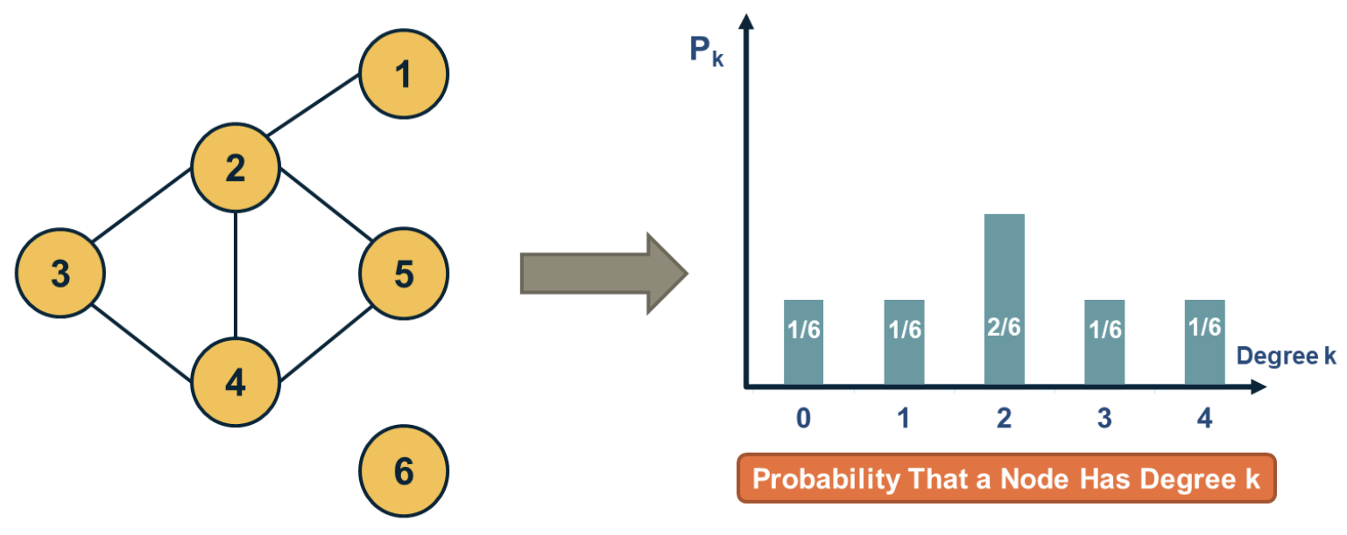
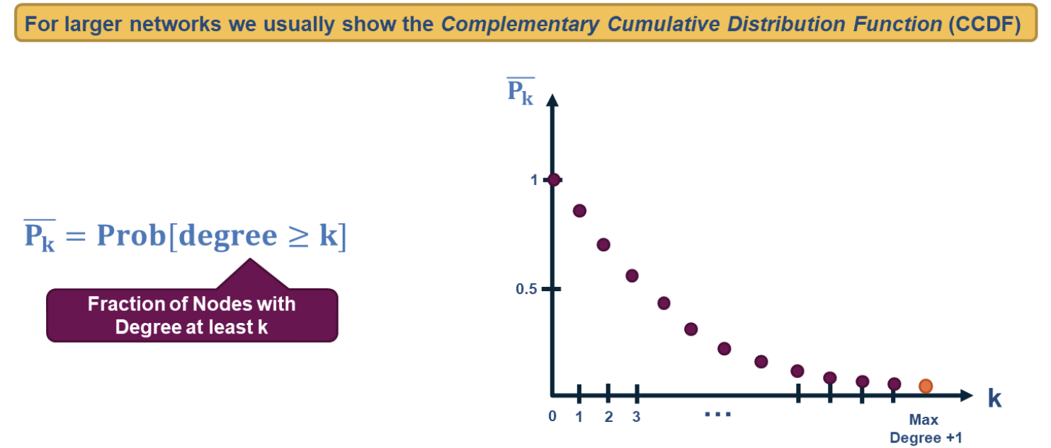
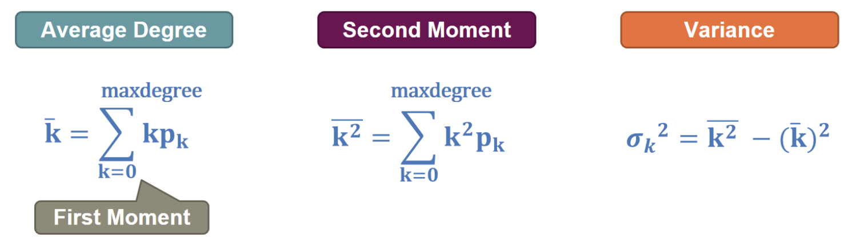
Degree distribution

Slide 22
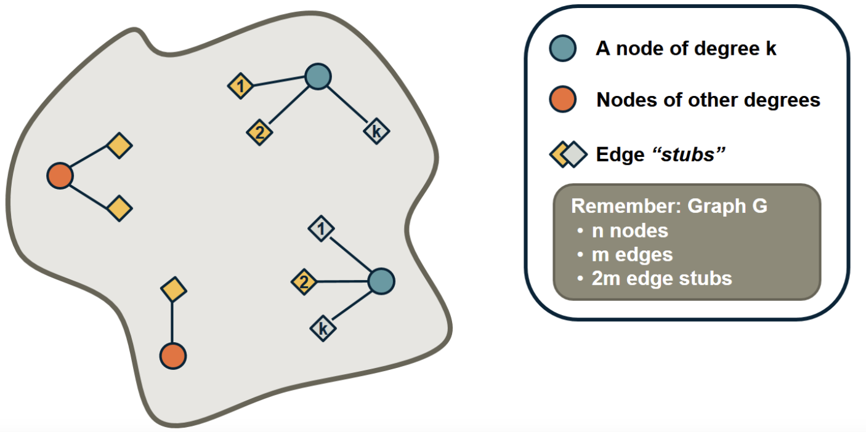
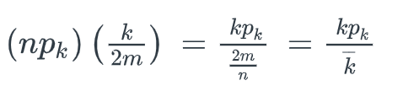
Friendship paradox: your friends have more friends than you!
Probability that random edge connects to node of degree k:
Average degree of neighboring node:

Slide 23
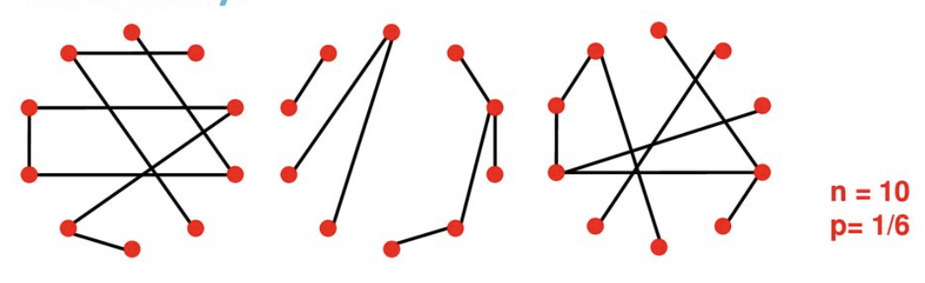
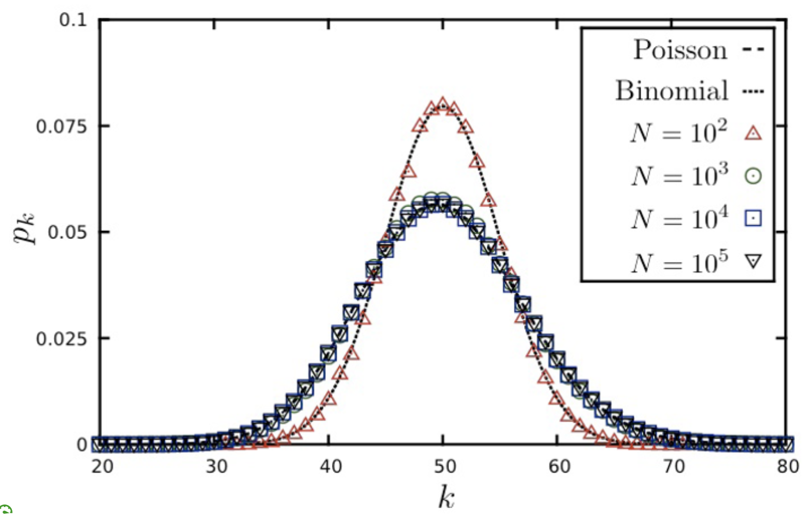
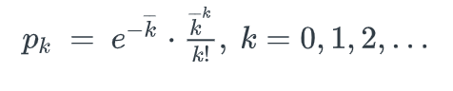
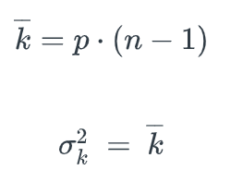
G(n,p) random graph model
n nodes,
p: probability two different nodes connected

Slide 24
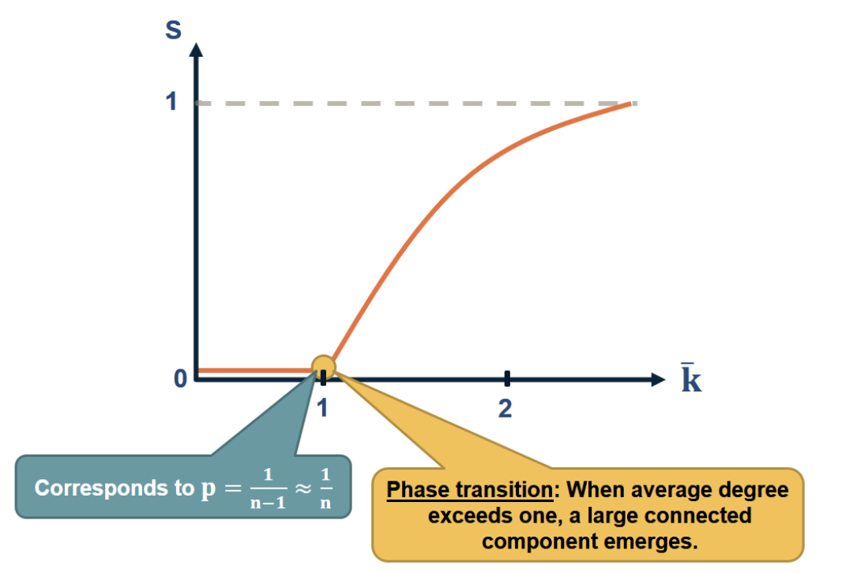
Emergence of giant connected component in G(n,p)
S: expected fraction of nodes in largest connected component

Slide 25
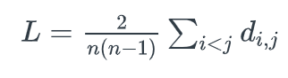
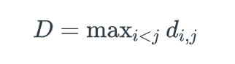
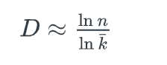
Average path length & diameter in G(n,p) networks
Average shortest-path length (a.k.a. CPL)
Diameter
In G(n,p) networks:
Example: with 7B people on the planet, and assuming that on the average we have 64 acquaintances, the diameter of the global social network would be about 5.4 hops

Slide 26
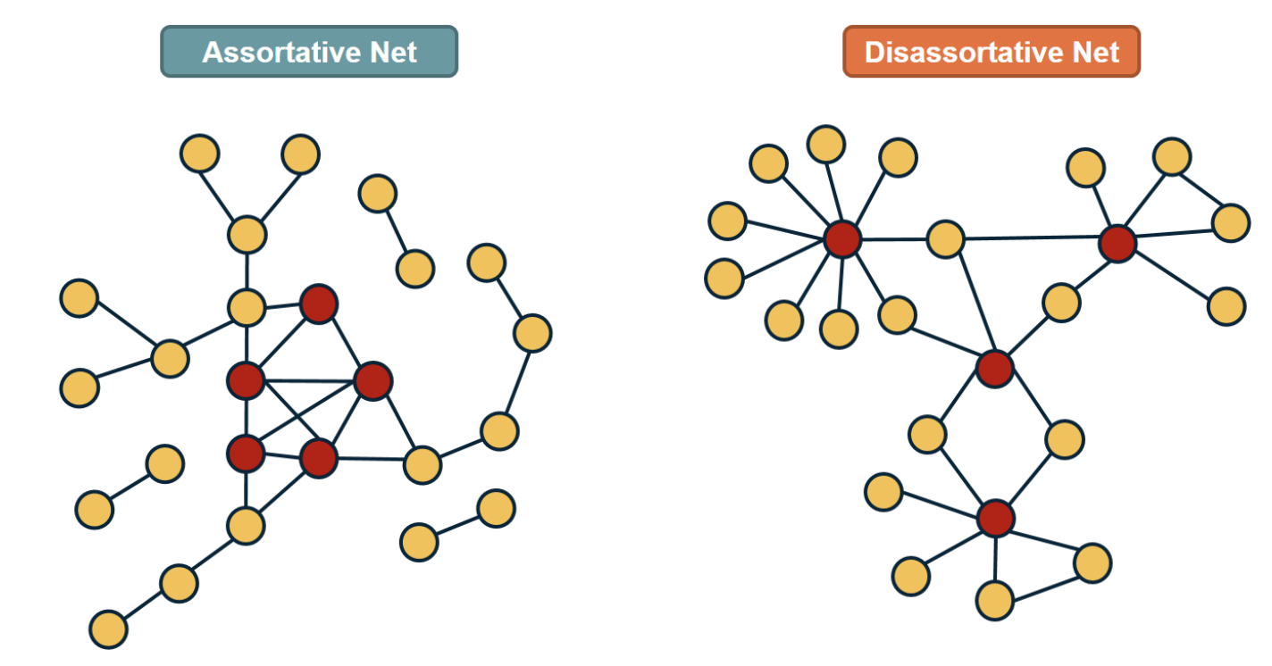
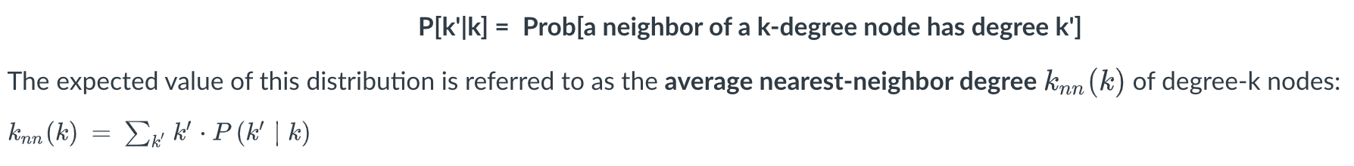

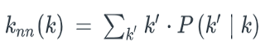
Degree correlations
Neutral networks: two adjacent nodes have independent degrees
Expected value of this distribution: average nearest-neighbor degree of degree-k nodes:

Slide 27
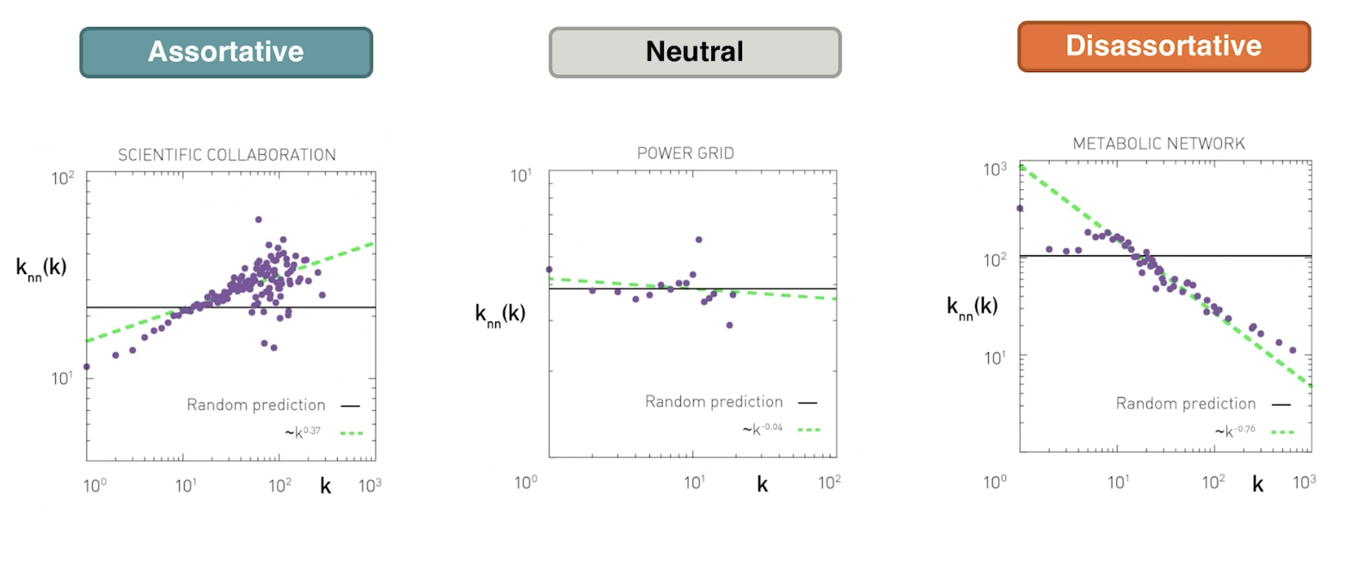
Degree correlations - examples

Slide 28
Network models

Slide 29
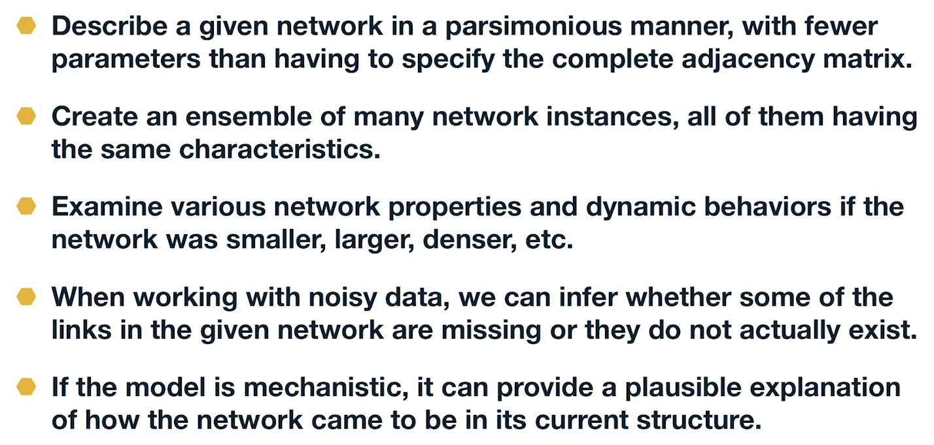
Why network modeling?

Slide 30
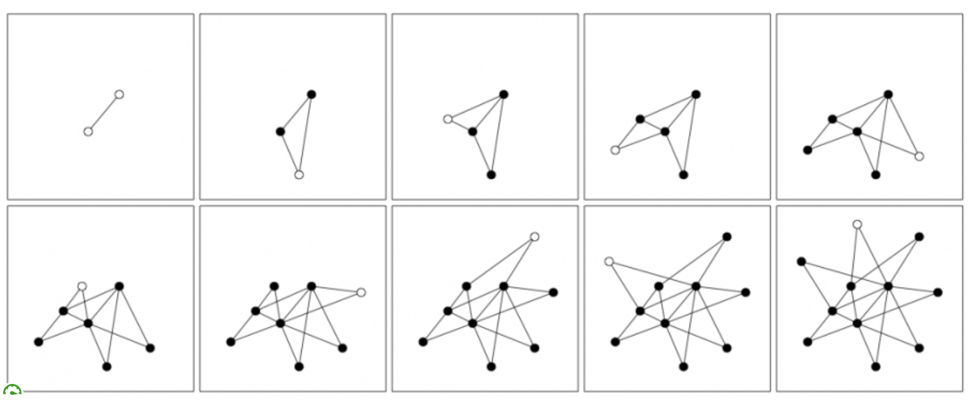
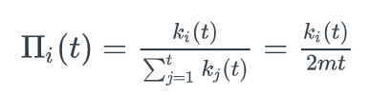
Preferential attachment – scale-free network

Slide 31
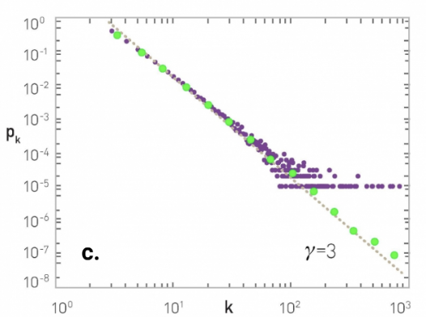
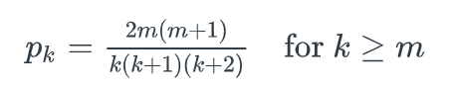
Preferential attachment – scale-free network

Slide 32
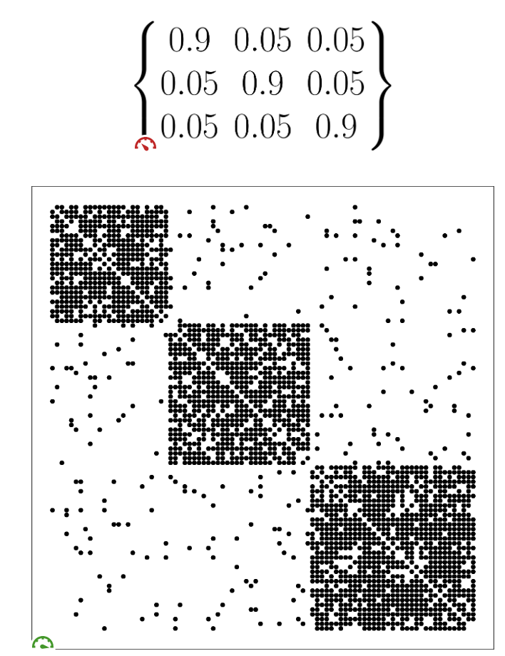
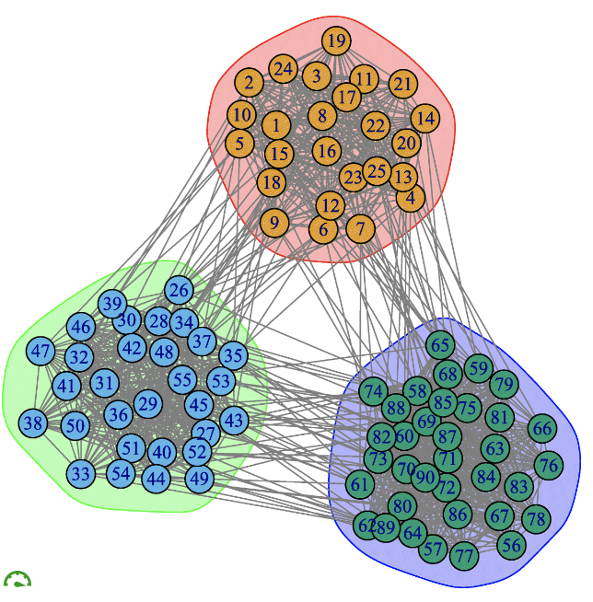
Stochastic Block Model (SBM)

Slide 33
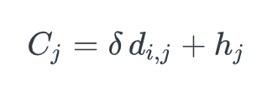
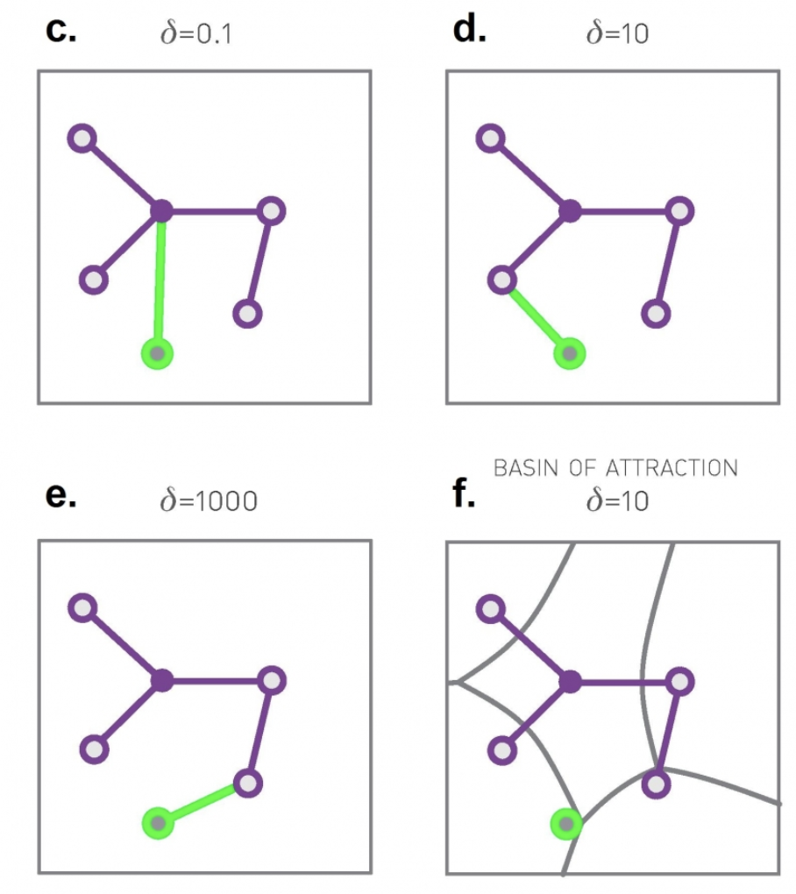
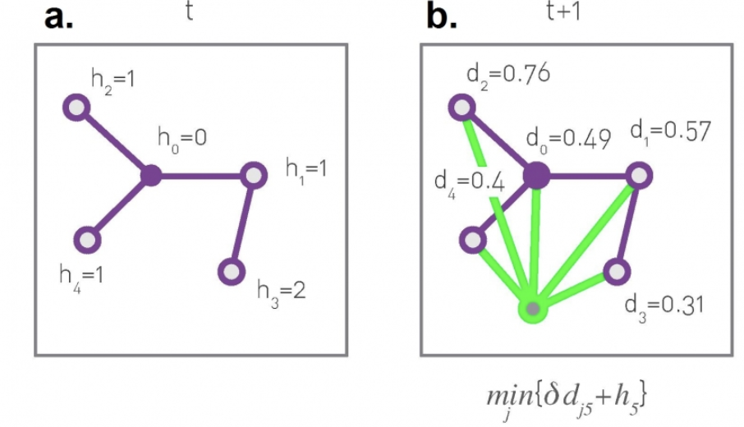
Optimization-based network formation

Slide 34
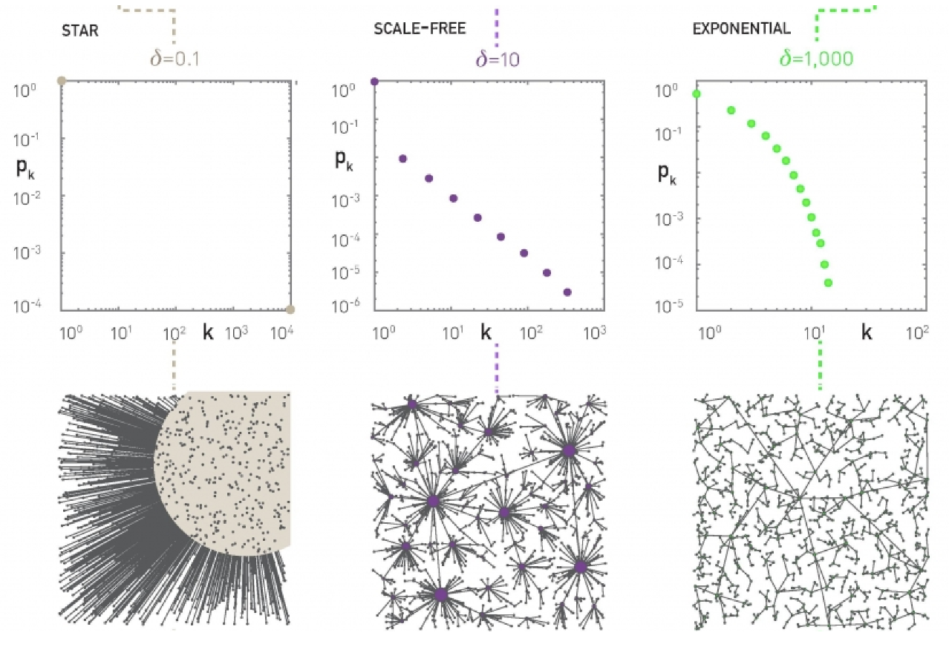
Optimization-based network formation

Slide 35
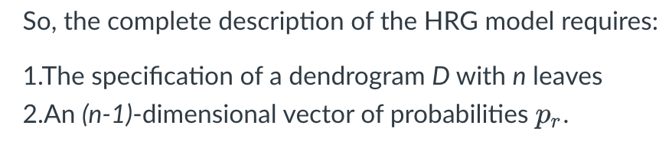
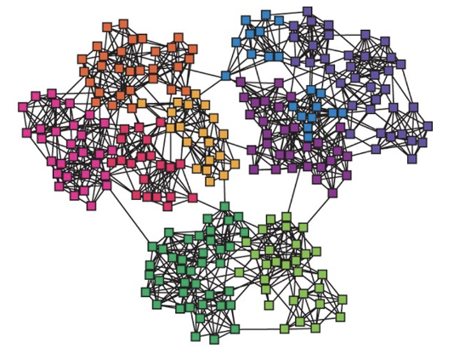

Hierarchical Random Graphs – learning a model from data

Slide 36



Maximum Likelihood Estimation of dendrogram probabilities

Slide 37


Dendrogram search using Markov Chain Monte Carlo (MCMC) optimization

Slide 38
Machine learning on graphs & graph neural nets

Slide 39



Node embeddings

Slide 40





Shallow embeddings based on node similarity

Slide 41





Random-walk embeddings (DeepWalk, Node2Vec)

Slide 42

Applications of node embeddings

Slide 43


Graph Neural Nets (GNNs)

Slide 44


Graph Neural Nets (GNNs)

Slide 45

Decoder & training with binary cross-entropy loss
Decoder: dot-product of embedding at last layer with softmax vector D

Slide 46


A GNN application: polypharmacy side effects

Slide 47

GNN - encoders

Slide 48

GNN - decoders

Slide 49

Deep generative models for graphs

Slide 50
Statistical sampling & inference on networks

Slide 51





Network sampling strategies

Slide 52



Network sampling strategies

Slide 53


Estimation of “network totals” using Horvitz-Thompson

Slide 54



Estimation of number of edges using Horvitz-Thompson

Slide 55






Link prediction using a node similarity metric

Slide 56
Modular networks
&
community detection

Slide 57

Clustering on graphs: community detection

Slide 58

Clustering on graphs: community detection

Slide 59




How to evaluate the partitioning of nodes in a given set of clusters?
Modularity metric:
Internal edges:

Slide 60

Which partition maximizes modularity?

Slide 61


Greedy modularity maximization

Slide 62



Hierarchical clustering + modularity maximization

Slide 63

Overlapping community detection

Slide 64

C-Finder algorithm (k-clique)

Slide 65
Dynamic processes on networks

Slide 66

“Spreading processes” (diffusion) on networks

Slide 67

Different classes of epidemic models

Slide 68



SI model – homogeneous mixing

Slide 69





SIS model – homogeneous mixing

Slide 70





SIR model – homogeneous mixing

Slide 71


Attack Rate (AR) and Reproductive Number R0

Slide 72

Is homogeneous mixing assumption realistic? Number of partners since sexual initiation (1996, Sweden)

Slide 73


The fallacy of the reproductive number in real contact networks

Slide 74







Degree block approximation – SIS model

Slide 75





No epidemic threshold for scale-free networks

Slide 76
Other topics in network science
Adaptive networks
Interdependent networks
Temporal networks
Network signal processing
Algorithms for very large graphs
Domain-specific networks (e.g., biological, brain, social, etc)
Many more..

Slide 77
The end..
If you want to talk more about any of this:
c.dovrolis@cyi.ac.cy

